Slide 1
Type of Event: Guest Lecture
Topic: EMFW
Speaker: Mr.K.N.S. HEMANTH, Subject expert at OHM , AIR 4 in IES,
State 5TH in AP TRANSCO, Alumni of BITS
Organised by: Department of Electronics and communication Engineering
Date: 01.09.2023 & 02.09.2023
Attended By: B.Tech (ECE-II YEAR,IV -YEAR)
Venue: Seminar Hall, A-Block
Time: 10:00 AM

Slide 3
Description:
The Guest Lecture was started with introduction to the OHM Institute team, Hyderabad. The welcome address was given by the HOD ECE,MRCE.
Mr. K.N.S.Hemanth has explained about EMWF subject for about 3 hrs. per day.
The aim and summary of the Guest Lecture is given below.
Aim of the Guest Lecture:
The rectangular coordinate system
cylindrical and spherical coordinate system
Divergence.
Curl.
vectors and scalars
How to solve GATE EMF problems in easier way
Summary of Presentations:
The expert has clearly explained the subject in a engaging way and he had answered all the queries asked by the students . The Guest Lecture was ended with the Vote of thanks.
Coordinators:
Ms.K.Aksa Rani, Assistant Professor, ECE Dept
Mrs.K.Maheswai,Assistant Professor, ECE Dept

Slide 4
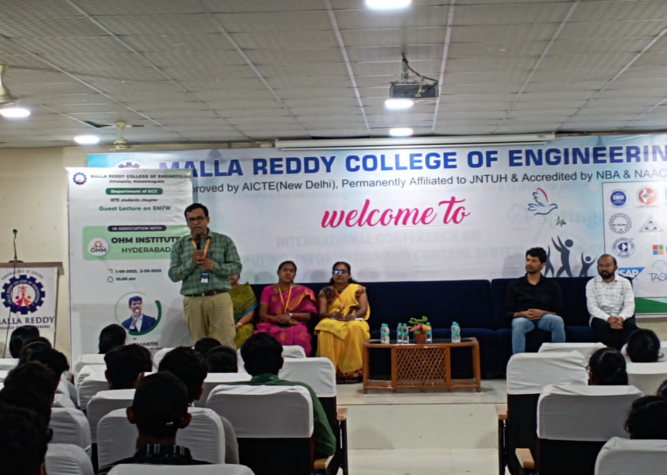
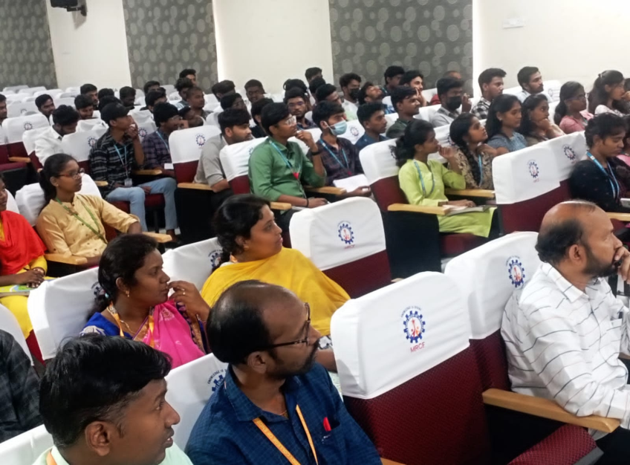
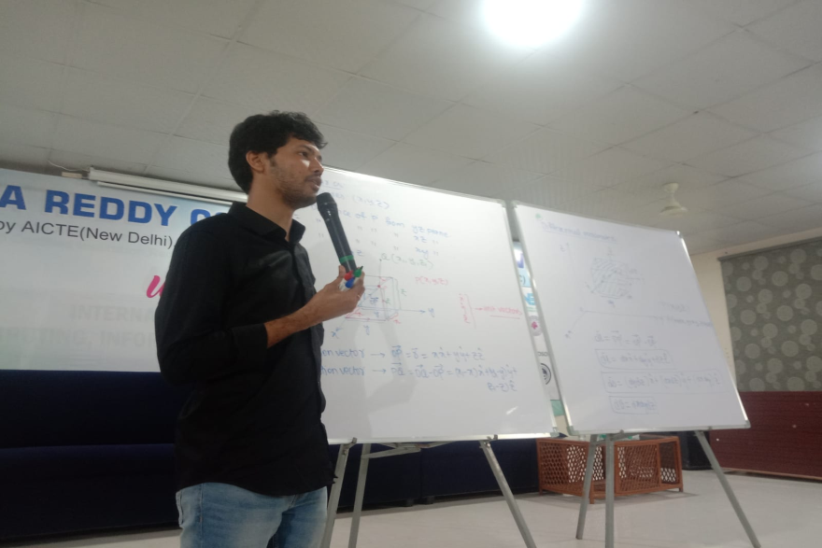
Day-1 (01-09-2023)

Slide 5
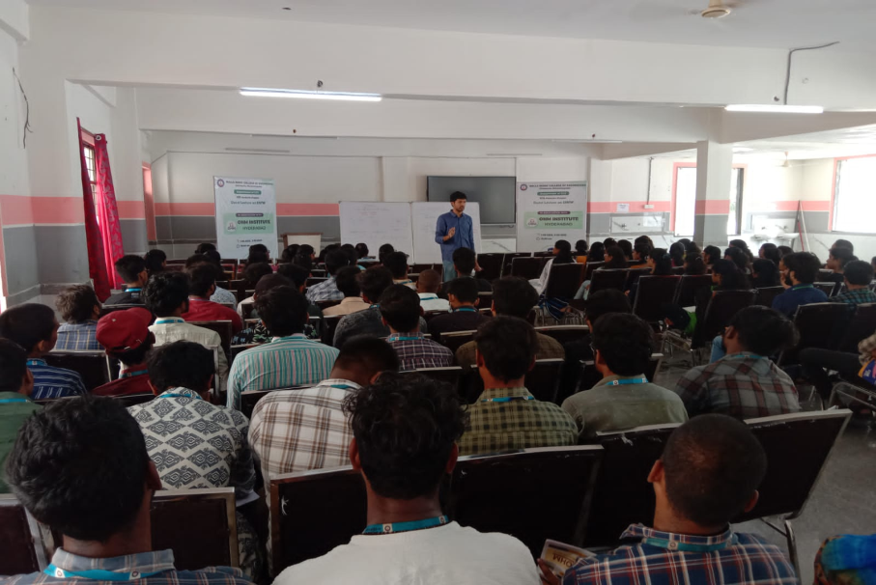
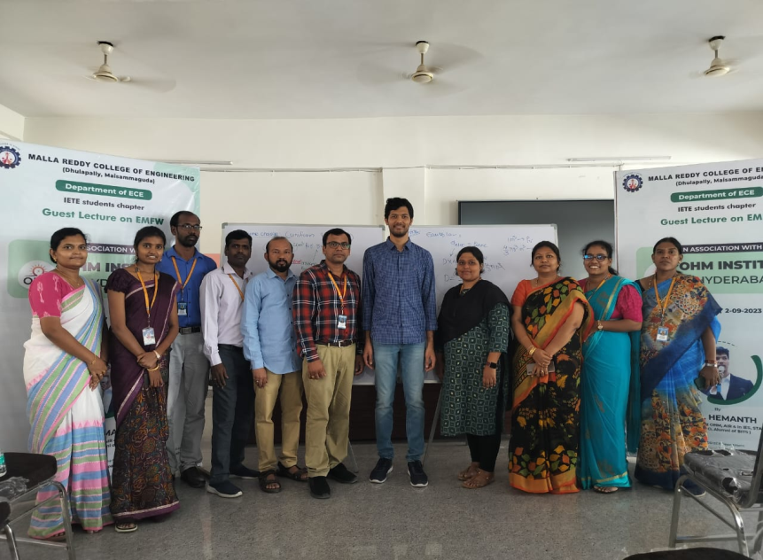
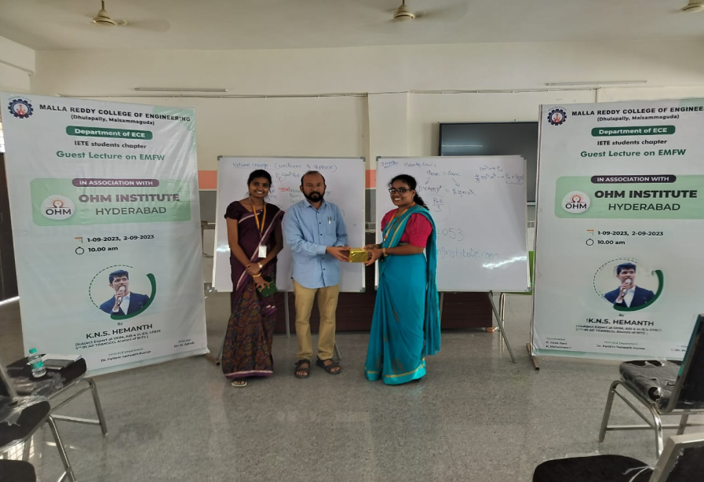
Day-2 (02-09-2023)

Slide 6
Thank you

